Slide 1
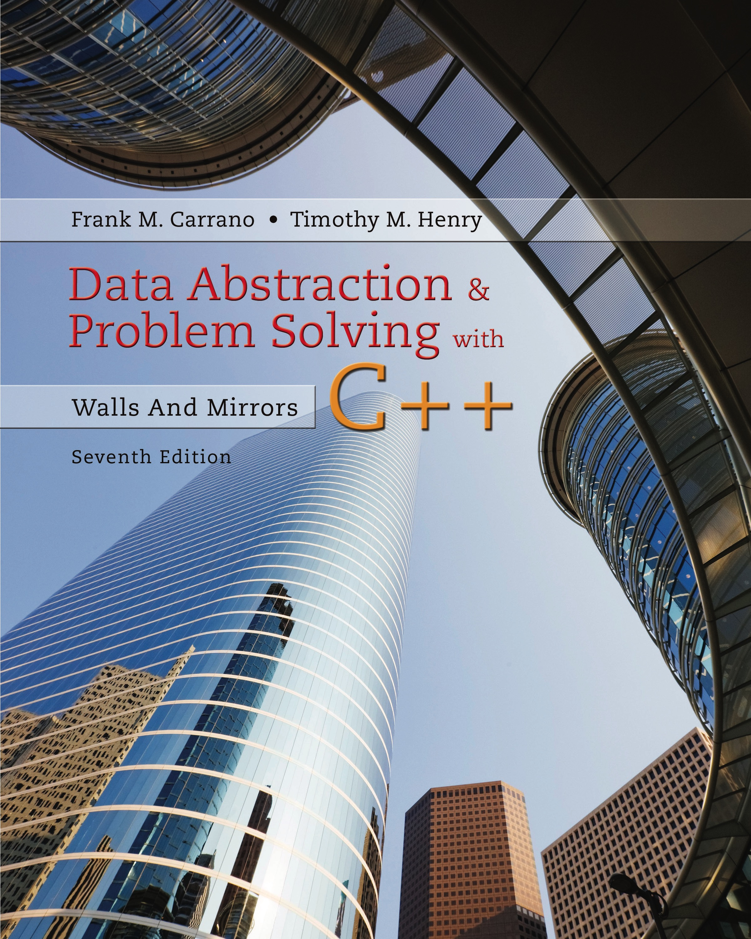
Data Abstraction & Problem Solving with C + +: Walls and Mirrors
Seventh Edition
C + + Interlude 1
C + + Classes
Copyright © 2017, 2013, 2007 Pearson Education, Inc. All Rights Reserved
Notes:
If this PowerPoint presentation contains mathematical equations, you may need to check that your computer has the following installed:
1) MathType Plugin
2) Math Player (free versions available)
3) NVDA Reader (free versions available)

Slide 2
A Problem to Solve (1 of 9)
Consider a video game where a character carries three types of boxes
Plain box
Toy box
Magic box
Plain box design
Get and Set public methods

Slide 3
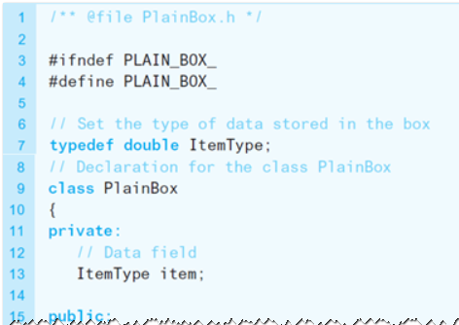
A Problem to Solve (2 of 9)
Listing C1-1 The header file for the class PlainBox

Slide 4
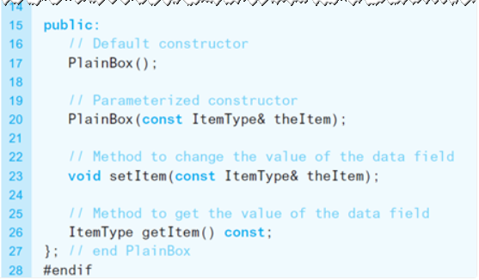
A Problem to Solve (3 of 9)
Listing C1-1 [continued]

Slide 5

A Problem to Solve (4 of 9)
Elements of the class
Private data fields
Constructors, destructors
Methods
Use of
preprocessor directives
Use of initializers
Use of typedef
Inheritance

Slide 6
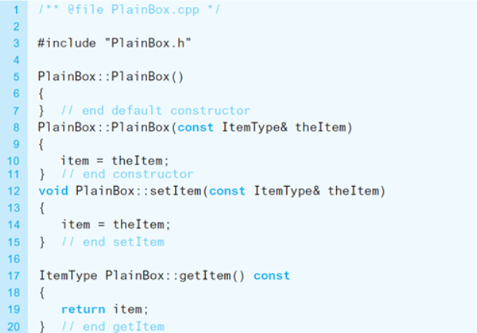
A Problem to Solve (5 of 9)
Listing C1-2 Implementation file for the PlainBox class

Slide 7
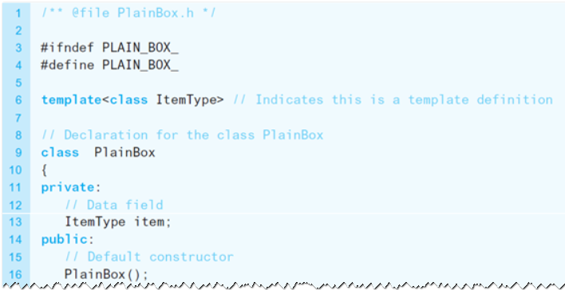
A Problem to Solve (6 of 9)
Listing C1-3 Template header file for the PlainBox class

Slide 8
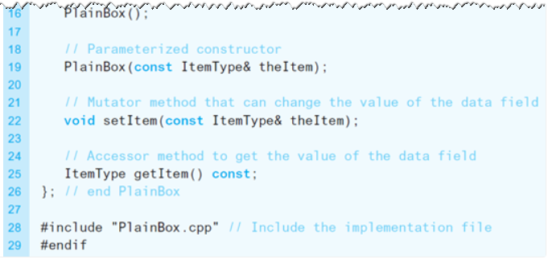
A Problem to Solve (7 of 9)
Listing C1-3 [continued]

Slide 9
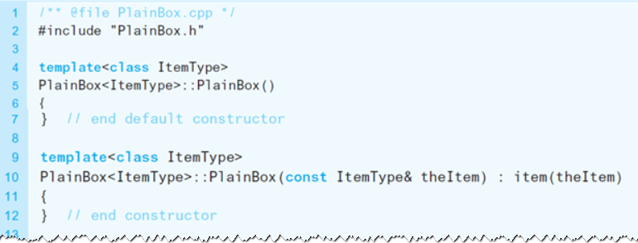
A Problem to Solve (8 of 9)
Listing C1-4 Implementation file for the PlainBox template class

Slide 10
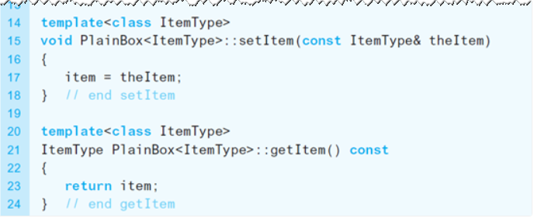
A Problem to Solve (9 of 9)
Listing C1-4 [continued]

Slide 11
Base Classes and Derived Classes (1 of 3)
Use PlainBox as a base class, or superclass
The ToyBox class is the derived class, or subclass, of the PlainBox
Derived class inherits
All the members of its base class,
(Except the constructors and destructor)

Slide 12
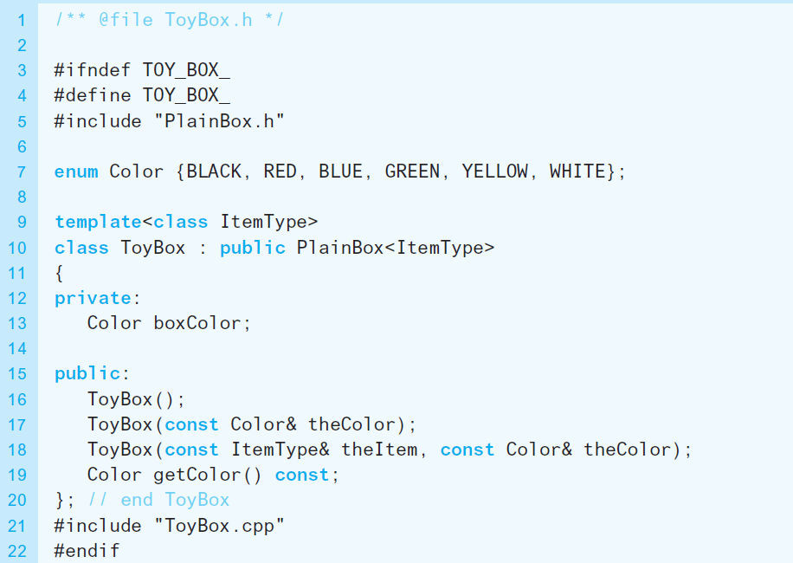
Base Classes and Derived Classes (2 of 3)
Listing C1-5 Template header file for the class ToyBox

Slide 13
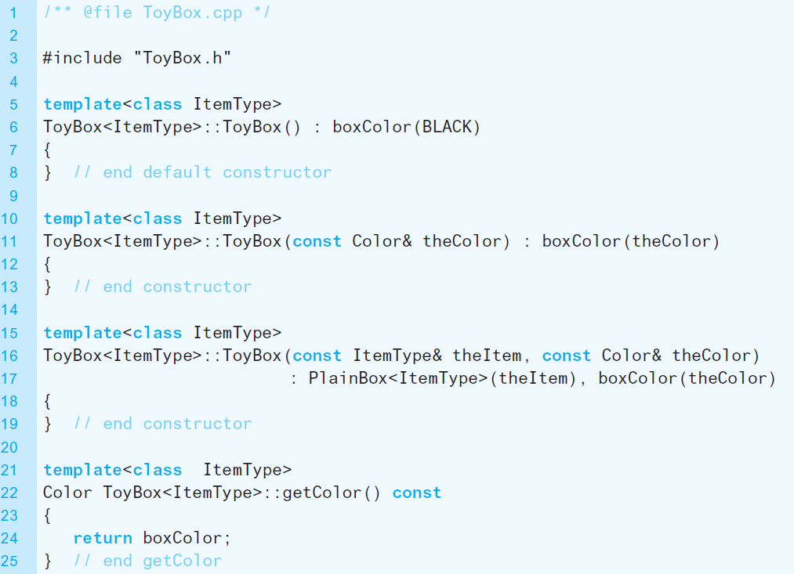
Base Classes and Derived Classes (3 of 3)
Listing C1-6 Implementation file for the class ToyBox

Slide 14
Overriding Base-Class Methods (1 of 3)
You can add as many new members to derived class as desired
You can redefine inherited methods
Called overriding a base-class method.
A method overrides a base-class method when
The two methods have the same name and parameter declarations

Slide 15
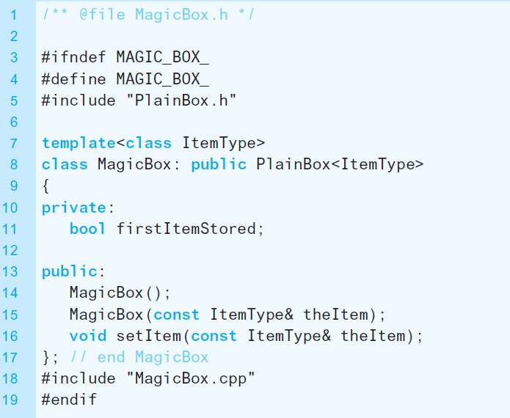
Overriding Base-Class Methods (2 of 3)
Listing C1-7 Header file for the class MagicBox

Slide 16
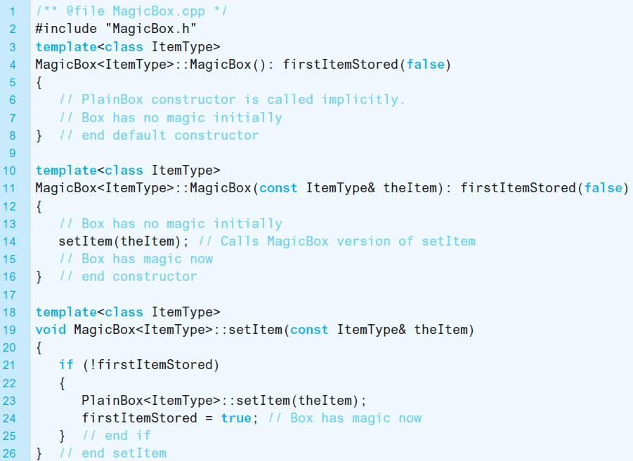
Overriding Base-Class Methods (3 of 3)
Listing C1-8 Implementation file for the class MagicBox

Slide 17
Virtual Methods, Abstract Classes (1 of 2)
Using keyword virtual in front of the prototype
Tells the C + + compiler that the code this method executes is determined at runtime
Pure virtual method
Virtual method that has no implementation
Abstract class
Has at least one pure virtual method

Slide 18
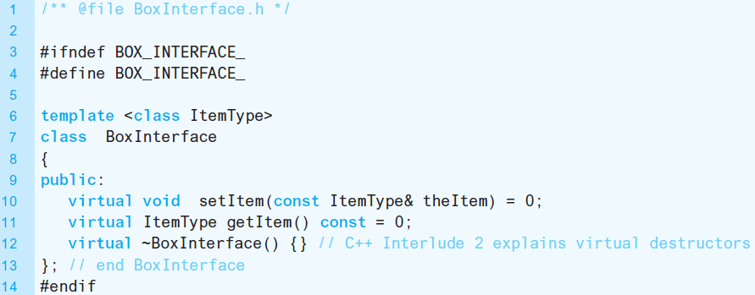
Virtual Methods, Abstract Classes (2 of 2)
Listing C1-9 An abstract class that is an interface for the A D T box

Slide 19

Copyright

